Slide 1


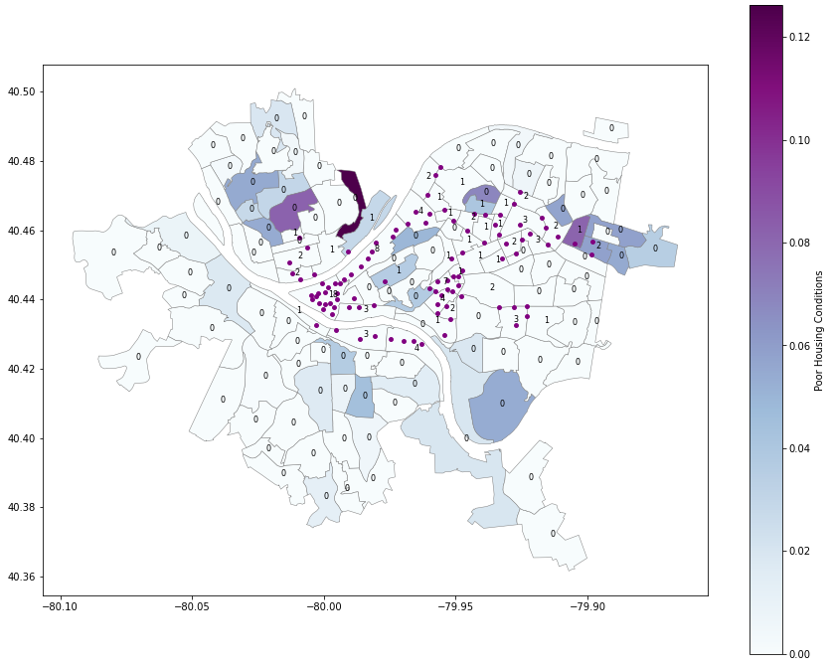
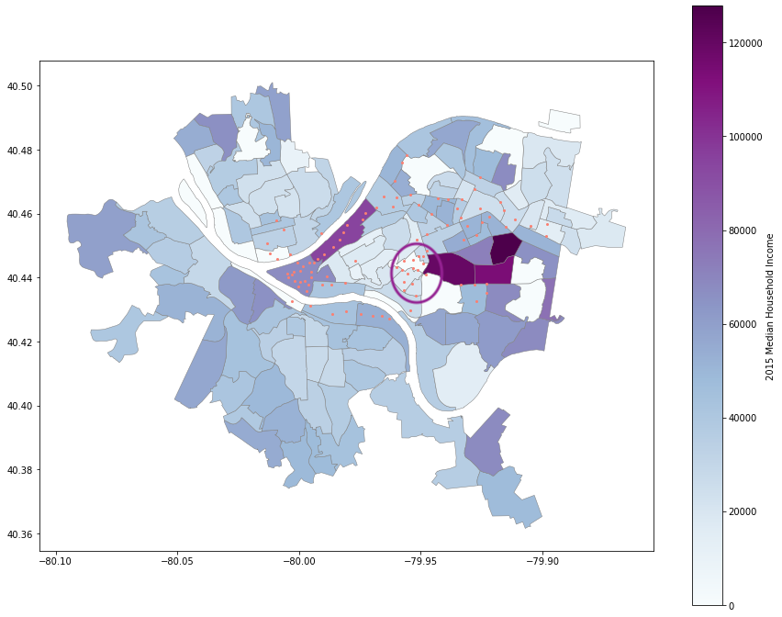
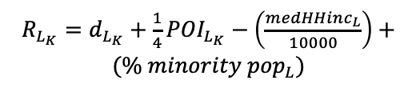
Reducing Discrimination in Learning Algorithms for Social Good in Sociotechnical Systems
Katelyn Morrison ~ Kmorrison@pitt.edu
Primary Questions & Hypotheses
Exploratory Analyses
Fairness in Station Location
How does the location of a bike station relate to the neighborhood’s socioeconomic status and demographics?
Agreeing with previous research [1-4], I predict the bike stations in Pittsburgh will be located primarily in medium to high-income neighborhoods.
How can we develop a model to help urban planners fairly allocate smart mobility resources?
If we investigate how to employ model-based reinforcement learning paired with Bayesian Optimization, it could be possible.
Datasets:
2020 FFIEC Census Report
Healthy Ride Bike Station Locations
Allegheny County Poor Housing Conditions
Allegheny County 2010 Census Tracts
Potential Model:
Model-based Reinforcement Learning paired with Bayesian Optimization.
Predict the optimal location that maximizes predicted demand while minimizing discrimination against demographics and income with following reward function, e.g.:
Analyses:
Figure 1 shows approximately 5% of bike stations are available in tracts with poor housing conditions.
Figure 2 reveals a significant outlier circled in purple of several bike stations in low-income tracts that makes up 3 universities.
$R_{L_{K}}=d_{L_{K}}+\frac{1}{4}{POI}_{L_{K}}−\left(\frac{{medHHinc}_{L}}{10000}\right)+({\% minority pop}_{L})$
Bike Station Location in Relation to Poor Housing Conditions in Pittsburgh, PA
Bike Station Location in Relation to 2015 Median Household Income in Pittsburgh, PA
Future Work
Identify more datasets that may be useful in exploratory analyses and training a model.
Identify other kinds of models that could be used.
References
[1] Cardona, Mateo, et al. “Analisis de la red de ciclorutas de manizales (colombia) a partir de criterios de accesibilidad territorial urbana y cobertura de estratos socioeconomicos”. Revista Espacios, 38(28), 2017.
[2] Garcia, Zuluaga , et al. “Propuesta metodologica para el diagnostico y planificacion urbana de una red de ciclorrutas. Caso estudio: Manizales.” PhD thesis, Universidad Nacional de Colombia- Sede Manizales, 2017.
[3] Mooney, Stephen J, et al. “Freedom from the station: Spatial equity in access to dockless bike share.” Journal of transport geography, 74:91–96, 2019.
[4] Liu, Yijia, et al. “Scooter Equity and Demand Analysis.” UPenn MUSA, Master of Urban Spatial Analytics (MUSA) - University of Pennsylvania, 11 May 2020, pennmusa.github.io/MUSA_801.io/project_14/index.html#5_model_building.
Figure 1: Mapping the location of bike stations to poor housing condition by census tract and station capacity.
Figure 2: Mapping the location of bike stations to 2015 median household income by census tract.

